Slide 1
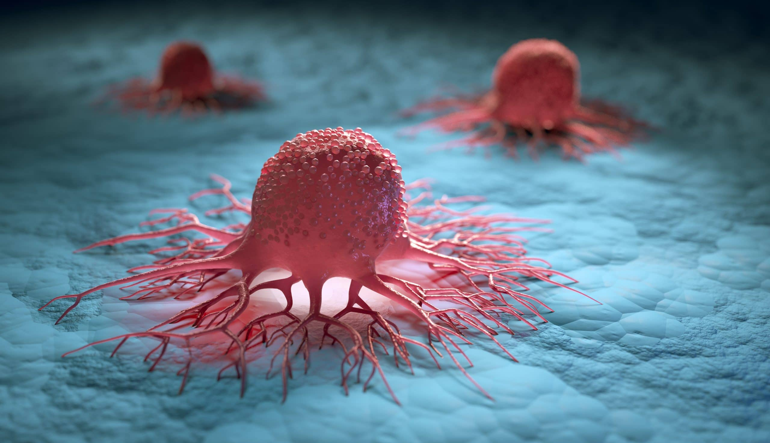

Intelligent Prostate Cancer Detection
Group 9
Image Segmentation & Gleason Grading Assessment for Early Detection and Diagnostic of Prostate Cancer Based on Neural Networks
Project Team
A0213498X Zhang Yu
A0213514U Anandan Natarajan
A0213498X Zhang Yu
A0213514U Anandan Natarajan

Slide 2


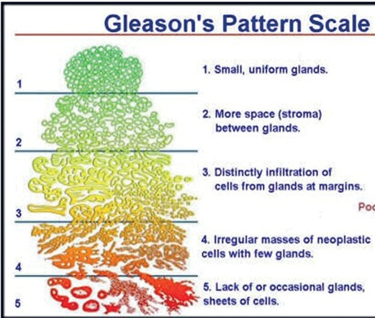
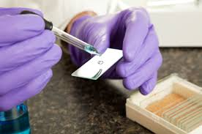
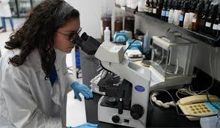
Current Methodology
Pathologist
1. Tissue Sample
2. Diagnostic Process
(Localization +Segmentation + Cancer Grading)

Slide 3
Current Methodology
Drawbacks due to manual analysis of the Pathologist
Time consuming
Errorprone
Limited Reproducibility
As a result the implications on the patient is
Delayed Treatment
Wrong medication

Slide 4
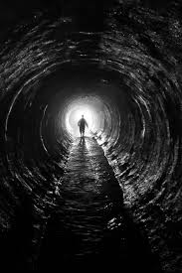
WHOA!
Don’t be dissapointed!
We @NUS ISS propose
a novel approach to provide
Image Segmentation & Gleason Grading Assessment
for
Early Detection and Diagnostic of Prostate Cancer Based on Neural Networks

Slide 5
Implementation Approach

Slide 6
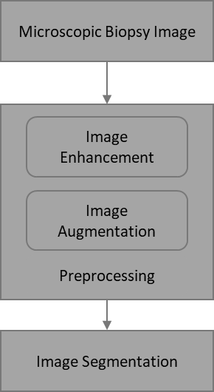
Implementation Model
Image Classification

Slide 7
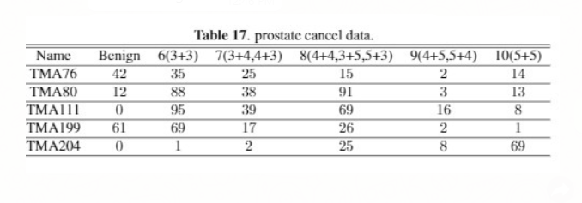
1 Dateset
Solid masks
Data spreads across different Gleason gradings
Readable image size 3100 * 3100 and easy to create patch

Slide 8
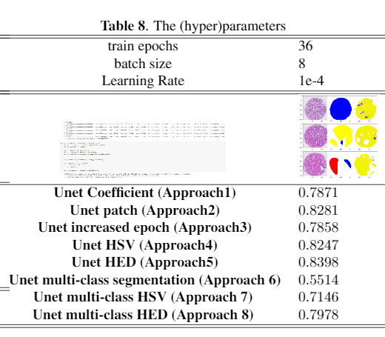
8 Segmentation Approaches
Conclusion
Approach 2 (Unet Patch), Approach 4 (HSV) and Approach 5 (HED) are more than 80%.
Classical Dice Coefficient Loss function is efficient(approach 1, 2,3,4 5) and have more accuracy than Multi-dimensional Dice Coefficient function (approach6, 7 and 8).
Patch Processing with half of the epoh (epoh=16) can reach the higher accuracy than Processing without Patch-ing (epoh =36), or patch processing with Higher Epoh(epoh-36).
More epoh does not mean higher accuracy. For eg.,Approach 3 (epoh=100) is not having good accuracy than Approach 1 (epoh=36)

Slide 9
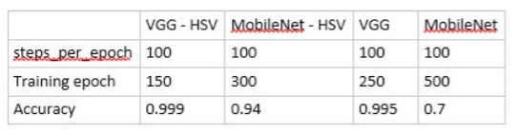
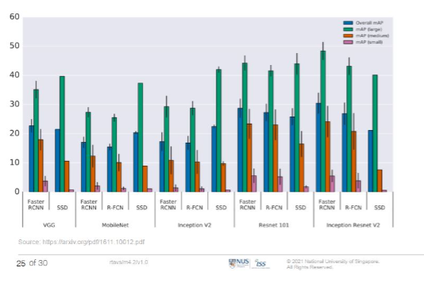
Classification of Segmented Image
VGG is good for small components.
MobileNet-HSV is faster and accurate.

Slide 10
Future Enhancements
More analysis can be done with combining multiple approaches to increase the accuracy of the model and we could use Otsu’s threshold in to mask off some artifacts/imperfection in HE stained images.
Use more geographical specific Private data-set to create and train the models to increase the usage of the model for specific institution (like major hospital).

Slide 11

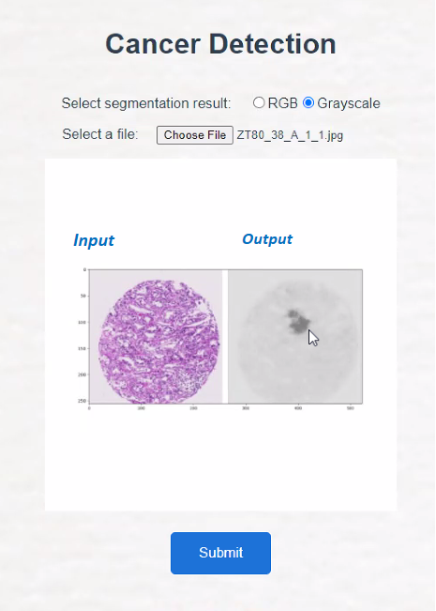
Intelligent Prostate Cancer Diagnosis
Segmentation
DEMO
Upload
Diagnosis
Result

